Slide 1
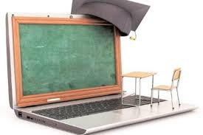
Continuous learning =
Education

Slide 2
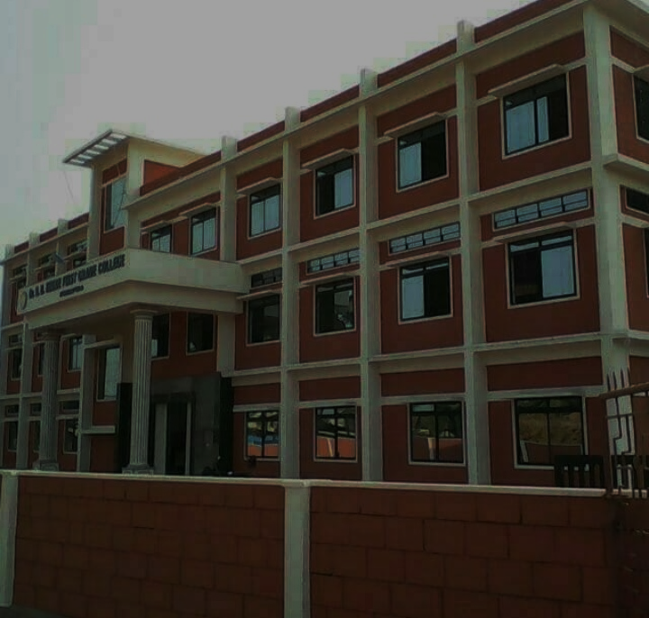
WELCOME
Mrs. VEENA BHAT
ASST. PROFESSOR & HOD
DEPARTMENT OF COMMERCE
BBHC, KUNDAPURA

Slide 3
Elements of cost
Material control
Objectives
Principles of MC
Elements of MC
Purchasing dept.
Centralized purchasing
Decentralized purchasing

Slide 4
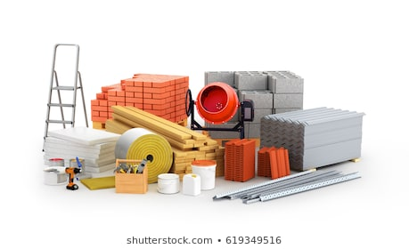
THREE ELEMENTS OF COST:
Material
Labor
Overhead
More than FIFTY PERCENT of the total cost of a product or a job is usually in the form of materials alone. In almost every industry a huge portion of working capital is invested in the form of inventories of which material is the major component.
The term 'materials’ as used generally, refers to raw materials, factory supplies (e.g. grease, oil etc.) and components, The terms 'materials', 'stores' and ‘inventory’ are often used interchangeably.

Slide 5
Material control:
Adequate and proper control of materials and other items of inventory from the time the production is planned until goods are sold and supplied, is an important feature of cost accounting system.
Material control is defined as a system which ensures the provision of the required quantity of material of the right quality at the required time with the minimum amount of capital.
It is a systematic control over purchasing, storing and consumption of materials, so as to maintain a regular and timely supply of materials, at the same time, avoiding over stocking. It is concerned with purchase, storage and use of materials so as to minimize wastage and losses.

Slide 6
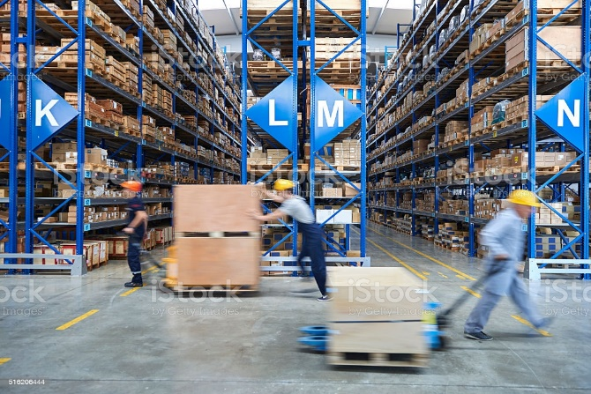
The process of material control is classified in three stages, namely, purchase, storage and issue of materials.
They are called
Purchase control
Inventory control and
Issue control.
It aims at control of materials at two levels, namely, quantity controls and financial controls.

Slide 7
OBJECTIVES OF MATERIAL CONTROL:
To provide a supply of required materials for efficient and uninterrupted operations.
2. To maintain the investment in inventories at the lowest level consistent with operating requirements.
3. Purchase of materials only when authoritative requests are received from the consumption departments and only when the need arises.
4. To make all purchases at minimum cost as per economic ordering quantity.
5. To purchase at the most favorable places, prices and terms.

Slide 8
6. To store materials with a minimum of handling time and cost and protect them from loss by fire, theft and damages.
7. To keep inactive, surplus and obsolete items to a minimum by systematic reporting of product changes which affect material requirements.
8. Issue of materials only on proper authorization and maintenance of proper accounts.
9. To fix up the responsibility for materials for some persons and positions.
10. To ensure payment for purchases only on receiving and accepting the materials.
11. Regular reports of purchases issue, stock etc., to the management in different types and sizes of business, quantities and cost of materials and component parts vary considerably.

Slide 9
PRINCIPLES OR ESSENTIALS OF MATERIAL CONTROL:
1.There should be proper cooperation and co-ordination among different departments and activities such as sales, production, purchasing receiving and inspection, storage, handling etc.
2.There should be proper system of budgeting and scheduling sales, stock and production.
3. Standard printed forms for reporting the activities connected with material control should be used.
4. A proper system of scheduling of materials should be followed.
5. A system of centralized purchasing should be followed under the control and supervision of a competent purchase manager.

Slide 10
6. A suitable procedure with regard to classification of materials should be followed.
7. A system of internal check by a number of properly authorized persons should be introduced to prevent fraud, misuse and theft.
8. An efficient system of communication between production, sales and purchasing department regarding all changes which may influence material requirement should be followed.

Slide 11
9. There should be proper usage and storage of materials.
10. Efficient and up to date stores records of quantity and value of each kind of material, at all times should be maintained.
11. A system of perpetual inventory control should be in operation in order to know the quantity and value of materials in the store at any time.
12. The levels of, stocks, namely, maximum, minimum and reorder, should be properly determined.
13. Pricing all issues of materials should be on a suitable basis to ensure accurate cost of production.

Slide 12
ELEMENTS OF MATERIAL CONTROL:
Material control extends to all spheres of material management, namely, buying, receiving and inspection, storing, consumption and accounting etc. It includes the following steps:
1. Purchasing of material. 2. Receipt and inspection of materials. 3. Storage of materials. 4. Issuing of materials. 5. Accounting of materials. 6. Keeping of physical and perpetual inventory records.

Slide 13
The most important elements of material control are:
1. Purchase of material
2. Inventory control and
3. Issue of materials.
I. Purchase of materials:
Industrial buying is an important function of management and a significant step in the process of material control.
Separate department is set up to handle all purchases.
The department has to decide what to buy, when to buy, from where to buy, how much to buy and at what price to buy the materials.
It is headed by purchase manager or supply manager or chief buyer.

Slide 14
Functions of Purchase Department:
Purchase department always aims at procuring different materials in the right quantity, of the right quality from the right source, at the right time and to supply them to different jobs and departments as and when required.
The primary functions of purchasing department are as follows: 1. Ensure continuous supply of materials to encourage continuous production. 2. Buy right type of materials in required quantity, at right price, from the right source. 3. Maintain adequate stock at minimum investment and cost. 4. Minimize the possibility of wastage, obsolescence, duplication and delay in supply of materials. 5. Select the suitable source of supply and develop alternative sources of supply. 6. Maintain the quality of materials bought.

Slide 15
Keeping in view a number of factors, e.g. types of products and raw materials, suppliers, distances, cost etc.. the choices to be made between centralized and decentralized buying.
CENTRALIZED BUYING:
Under centralized purchasing one central department makes all purchases for the whole organization. One purchase department is responsible to buy on behalf of different departments of the firm. Individual departments have no right to buy their requirements directly from the market. This policy is adopted by the medium size and big companies.

Slide 16
Advantages:
The main advantages of centralized purchasing are,
1. It enables consolidation of orders of materials commonly used by two or more departments. It enables quantity buying and brings economies in buying.
2. It helps to maintain uniform and firm buying policy.
3. It is the specialized buying by expert staff with the exclusive function of buying.
4. It helps in quick implementation of purchase policy and plan.

Slide 17
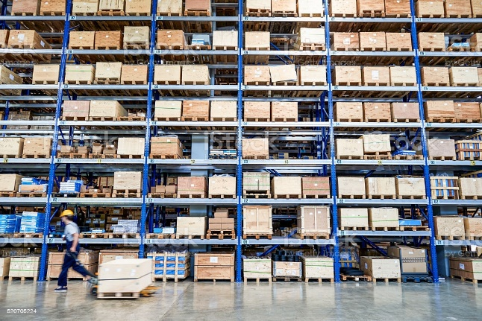
Disadvantages:
The major disadvantages of centralized buying are: 1. The buying procedure is less flexible. Quick adjustments in accordance with the changed requirements of a particular department cannot be made.
2. It will lead to high initial cost of setting up a new department.
3. It will result in undue delay in supply of material.
4. It is very difficult to maintain up to date record of different departments.

Slide 18
5. It facilitates the maintenance of one complete set of records to purchase transactions.
6. It minimizes the possibility of duplication of efforts in purchasing.
7. It helps to avoid excess stocking.
8. It helps to gain recognition to purchasing as a major function of the organization.
9. It facilitates to develop effective utilization of trade relations.
10. It enables economy in recording and accounting the purchase transactions.
11. It leads to prompt reporting on scrap, obsolete stocks and loss in storage.
12. It helps to reduce material cost through economies of large scale buying.(e.g., quantity discount, cash discount, favorable terms etc.) 13.Specialised buying, economy in recording and avoiding duplication of activities etc.

Slide 19
DECENTRALIZED BUYING:
Decentralized purchasing is the reverse of centralized purchasing. Each department makes its own purchases. When different units of an industry are situated far apart it is desirable to decentralize the purchasing function. The limitations of the centralized buying become the
advantages of this method of buying.
Advantages:
1. It brings in the benefits of local purchases (i.e. low prices, seasonal prices etc.).
2. Transportation costs may be reduced.
3. It enables easy local sales by the contact with local suppliers.
4. Prompt settlement of complaints, rejections, shortages or excess receipts etc. is possible, here.

Slide 20
5. Personal attention by the departmental head to buying problems as he can be held responsible for the purchases and overall performance of his department.
6.It reduces costly order processing procedures.
7. It helps to cut down lead time.
8. This system gives purchasing personnel authority and responsibility.
The advantages of centralized buying act as the limitations of this type of buying.
Often a combination of these two methods may be adopted where high value materials are bought centrally and materials of low value and dissimilar materials are left to be bought by the individual departments. But copies of purchase orders are to be sent to the central purchase department to ensure uniformity in the terms and conditions.

Slide 21
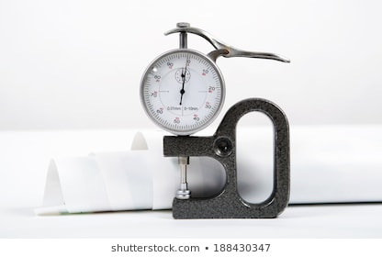
Elements of cost
Material control
Objectives
Principles of MC
Elements of MC
Purchasing dept.
Centralized purchasing
Thank you
Decentralized purchasing

Slide 22
Thank you

